Slide 1
PROBLEMS RELATED TO ISOMETRIC PROJECTION

Slide 2
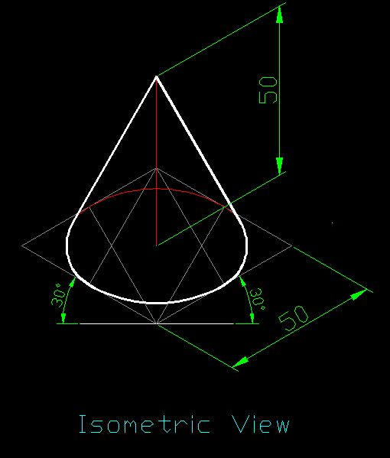
Q 1. Draw isometric view of a cone of base diameter 50 mm and height of axis 50 mm.

Slide 3
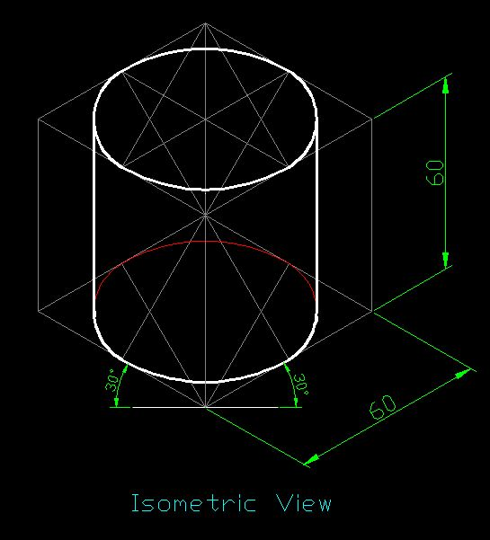
Q 2. Draw isometric view of cylinder of base diameter 60 mm and height 60 mm.

Slide 4
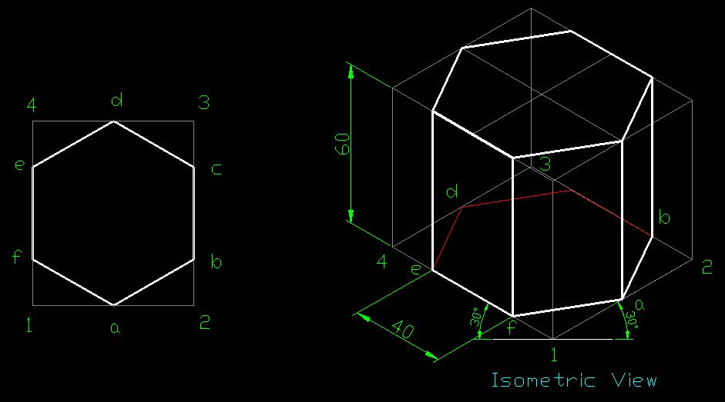
Q 3. Draw isometric view of hexagonal prism of side 40 mm and height 60 mm.

Slide 5
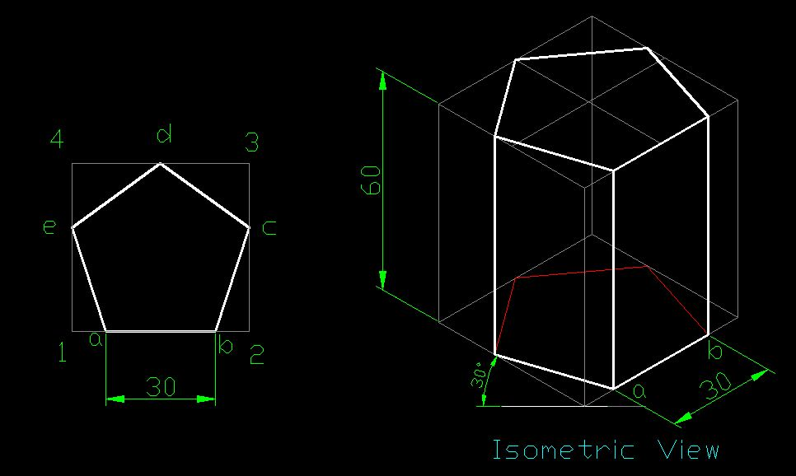
Q 4. Draw isometric view of pentagonal prism of side 30 mm and height 60 mm.

Slide 6
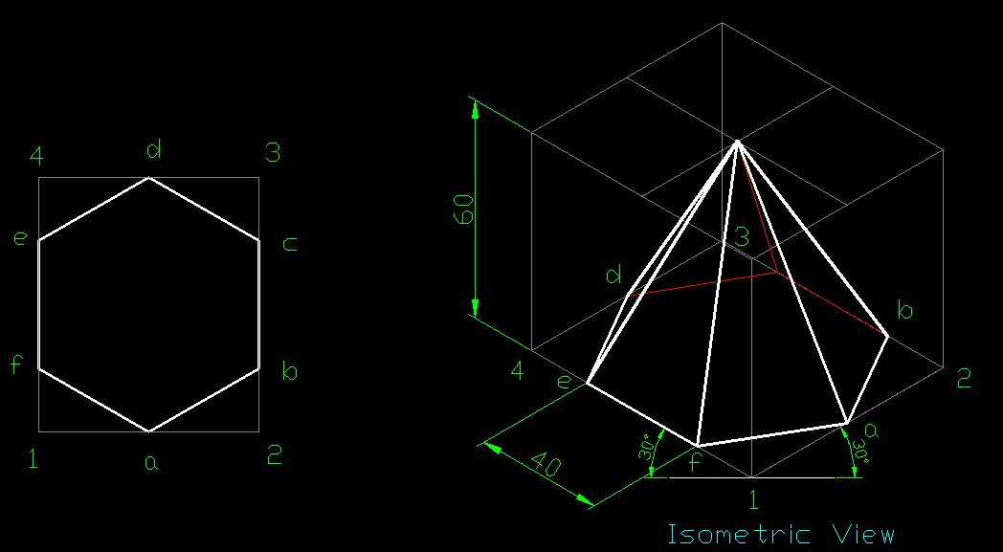
Q 1. Draw isometric view of hexagonal pyramid of side 40 mm and height 60 mm.

Slide 7
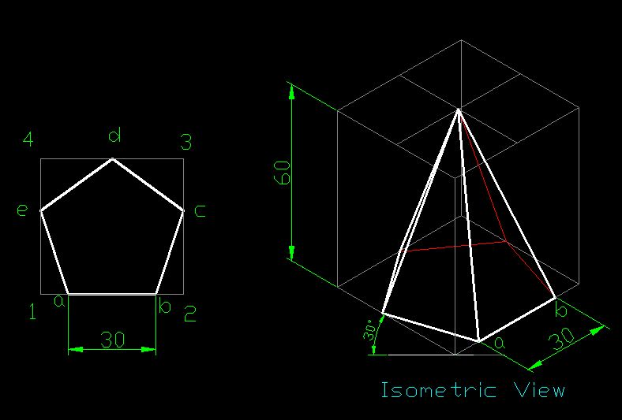
Q 2. Draw isometric view of pentagonal pyramid of base 30 mm and height 60 mm.

Slide 8
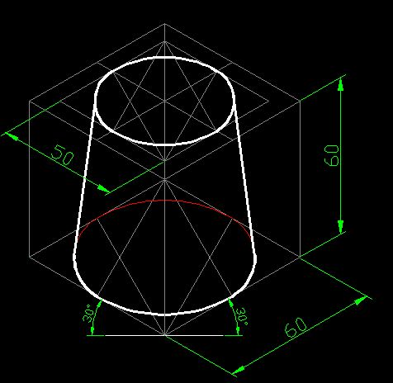
Q 3. Draw isometric view of frustum of cone whose larger base diameter is 60 mm and smaller diameter is 50 mm. It is resting on its larger base and take height as 60 mm.

Slide 9
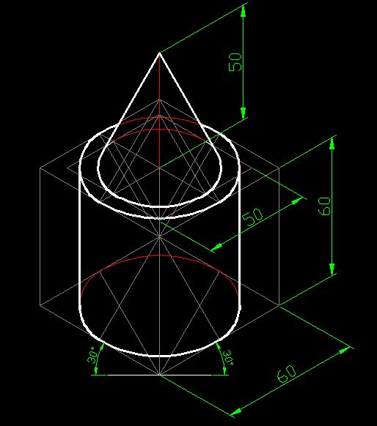
Q 3. A cone of base diameter 50 mm and height 50 mm is resting centrally on top of cylinder whose base diameter is 60 mm and height 60 mm. Draw the isometric view of the two solids.

Slide 10
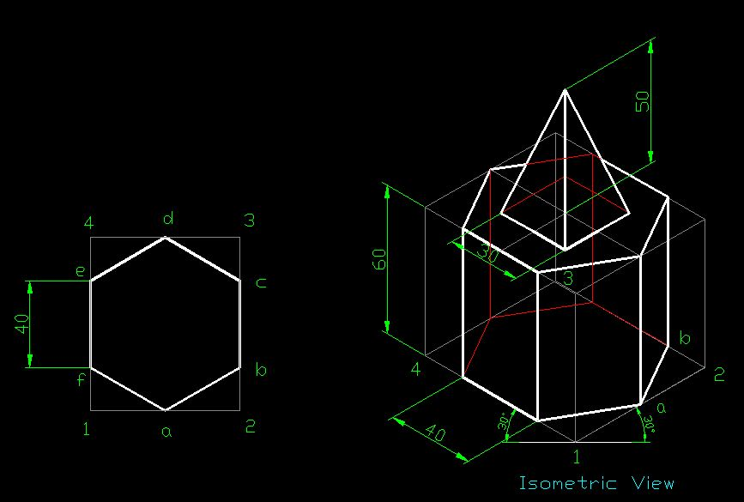
Q. A square pyramid of side 30 mm and height 50 mm is resting centrally on top of hexagonal prism whose side is 40 mm and height 60 mm. Draw isometric view of the two solids.

Slide 11
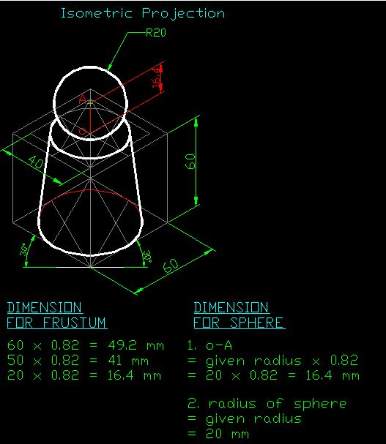
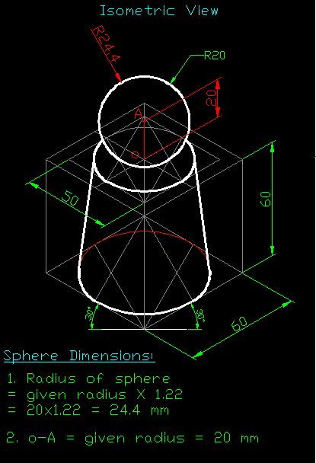
Q. A sphere of diameter 40 mm is resting centrally on top of cone frustum whose larger base diameter is 60 mm and smaller diameter is 40 mm and height 60 mm. Draw a) Isometric Projection of two solids, b) Draw Isometric view of two solids.

Slide 12
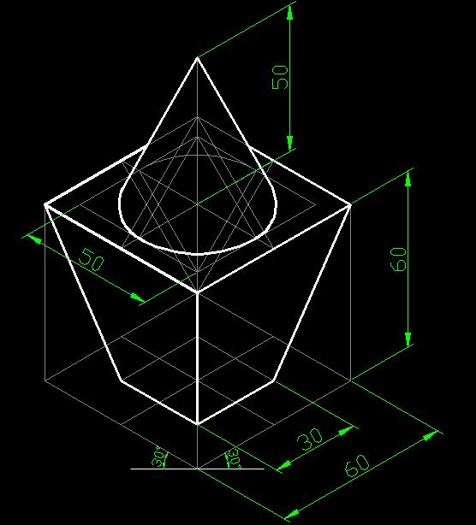
Q. A cone of base diameter 50 mm and height 50 mm is resting centrally on top of square base frustum whose smaller base is 30 mm, larger base is 50 mm and height 60 mm. The square base frustum is resting on its smaller base. Draw isometric view of the two solids.

